Slide 1
COLLEGE OF COMPUTING AND INFORMATICS TECHNOLOGY
“A Garden Monitoring Tool Based on computer vision and Machine
Learning”
By
Name: Joseph Lusoma, studentNo: 2200701194,
RegNo: 2022/HD05/1194U
DEPARTMENT OF COMPUTER SCIENCE
SCHOOL OF COMPUTING AND INFORMATICS TECHNOLOGY
Final Project Report
MCS 7224: Computer Vision

Slide 2
1
Presentation Links:
1. Video Presentation:
https://www.youtube.com/playlist?list=PL8SVbStCURHyUIvlqmacVNaWuAerIumyS

Slide 3
1
Chapter 1
INTRODUCTION
The crop and grass identification tool based on computer vision and machine learning is a powerful solution designed to accurately recognize and classify various crops and grass species. With the increasing demand for precision agriculture and landscape management, the ability to identify and monitor specific plant species is crucial for optimizing resource allocation, managing crop health, and preserving biodiversity. This report provides an overview of the tool's purpose and objectives, highlighting the importance of accurate identification for agricultural practices, landscape management, and ecological studies.
Approach and Correctness.
we explore and compare two approaches that can be used to monitor a garden
a) Use KNN machine learning model,
b) using a deep learning model using a CNN architecture. These models will contribute to the existing literature on computer vision in agriculture detection by utilizing grayscale images, incorporating data generators, employing dropout regularization, enabling multiclass classification, and adopting standard evaluation metrics.

Slide 4
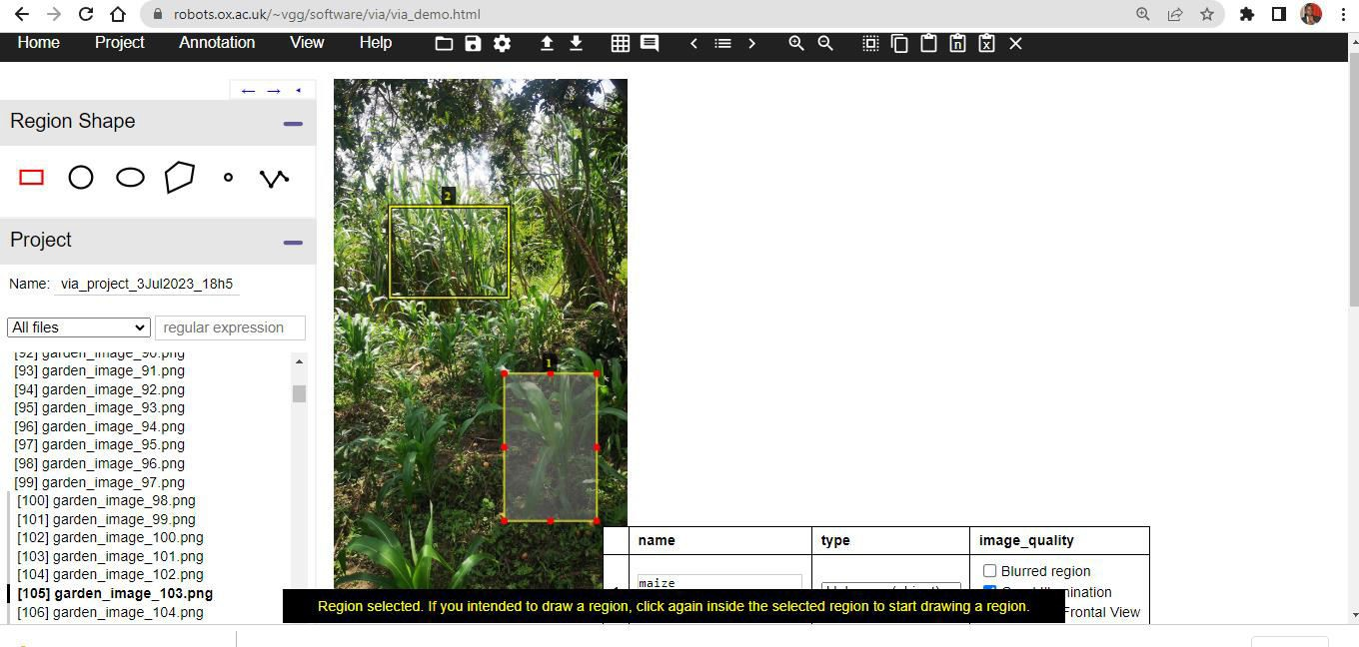
3.3 Implementation
3.3.1 Dataset Description
The dataset used for this model it was downloaded from google drive: https://drive.google.com/drive/folders/1pcmDtKW9R6TBs1E3IlWtRe19onVUe1pM?usp=shar ing. The data used to train the models is extracted from the video and is separated into their respective labels banana, cassava, maize and weed. The data was manually cleaned by
a. Ffmpeg was used to extract images from the video i.e
ffmpeg -i "Garden Video.mp4" -r 8 train\garden_image_%02d.png
was used extract 8 images per second of the video a total of 2075 images were generated
removing the unwanted images which were not necessary for building the model.
Images were manually annotated through this https://www.robots.ox.ac.uk/~vgg/software/via/via_demo.html.
website:

Slide 5
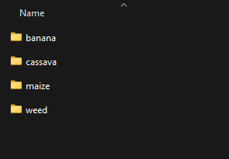
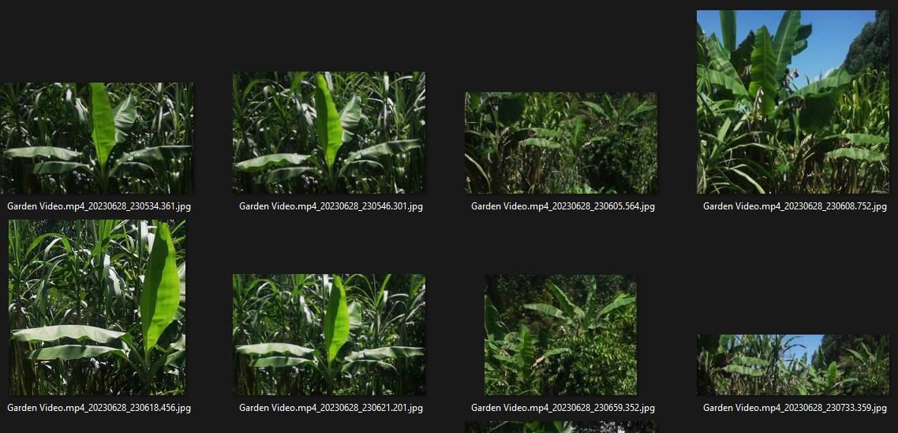
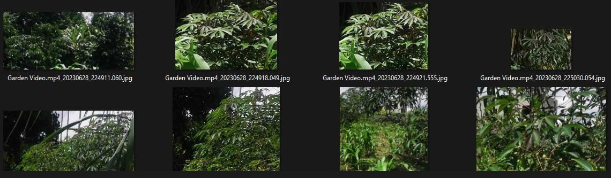
3
Data Preparation and Exploratory Data Analysis.
KNN Model
Data Directory Structure
Data Directory Structure:
The dataset was organized into separate directories for training and validation.
Dataset 1: Banana
Dataset 2: Cassava

Slide 6
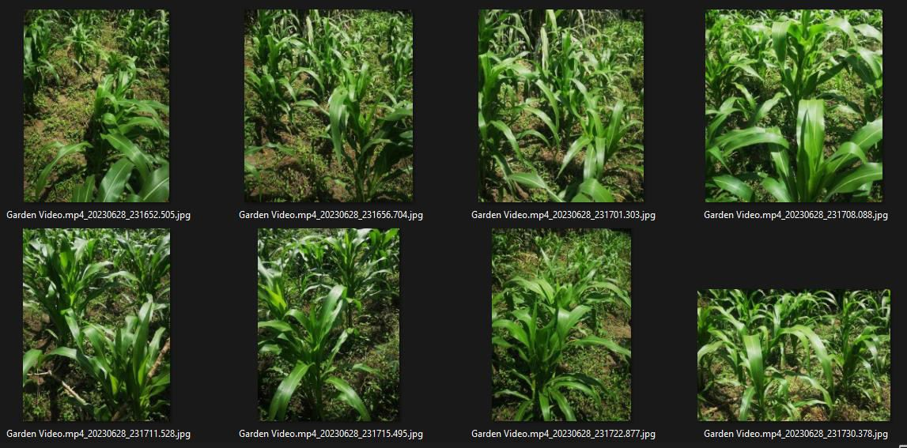
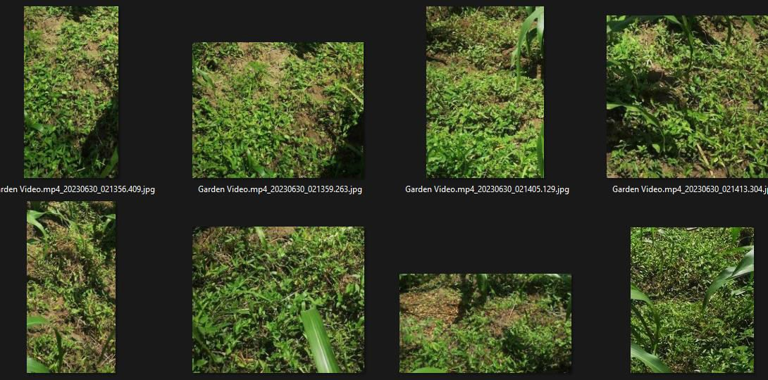
4
Dataset 3: Maize
Dataset 4: Weed

Slide 7
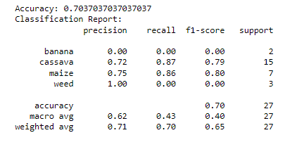
6
KNN Model Performance and Evaluation

Slide 8
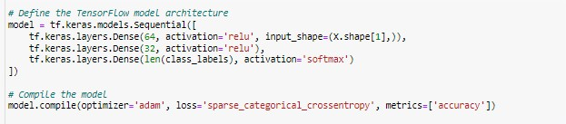
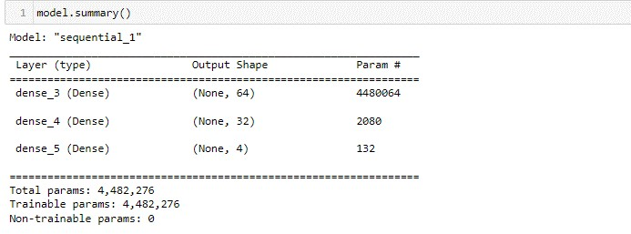
CNN MODEL
Implementation 1: CNN Model Architecture
3.3.4 Model Performance Evaluation
Implementation 2: Model Summary

Slide 9
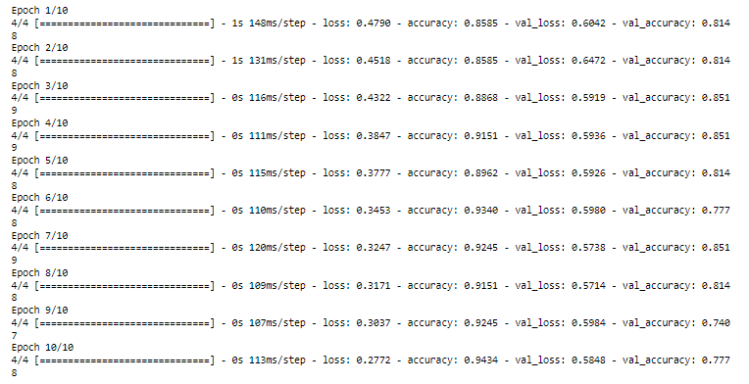

Slide 10
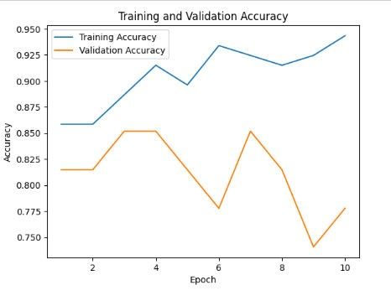
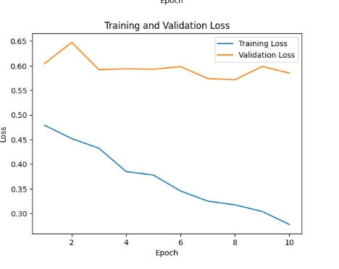
12
Implementation 4: Training vs Validation Accuracy
Implementation 5: Training Vs Validation Loss

Slide 11
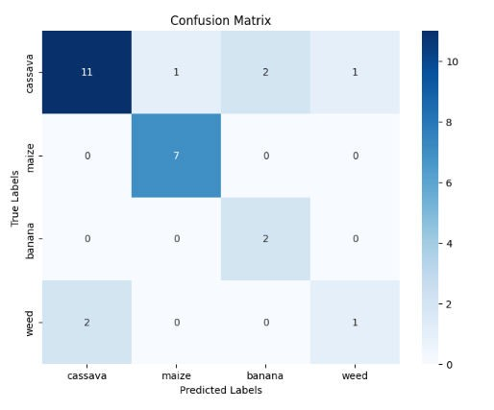
13
Implementation 6: Confusion Matrix
For the true label "cassava", the model predicted it correctly 11 times, misclassified it as "maize" once, misclassified it as "banana" twice, and misclassified it as "weed" once.
For the true label "maize", the model predicted it correctly 7 times.
For the true label "banana", the model misclassified it as "cassava" twice.
For the true label "weed", the model predicted it correctly once, misclassified it as "cassava" twice.

Slide 12
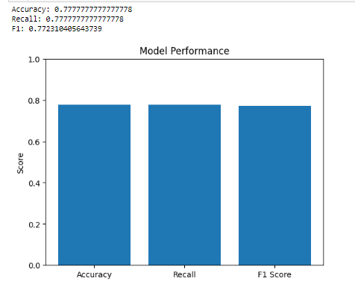
14
Implementation 7: Model Performance
The results provided include accuracy, recall, and F1 score. Here's an explanation of each metric:
Accuracy: 0.7777777777777778. This metric represents the overall accuracy of the model in correctly classifying the samples. It indicates that the model achieved an accuracy of approximately 77.78%.
Recall: 0.7777777777777778. Recall, also known as sensitivity or true positive rate, measures the proportion of actual positive samples that are correctly classified by the model. In this case, the recall is approximately 77.78%, indicating that the model has a similar performance in correctly identifying positive samples.
F1-Score: 0.772310405643739. The F1-score is the harmonic mean of precision and recall. It provides a balanced measure of the model's performance by considering both precision (ability to correctly classify positive samples) and recall (ability to correctly identify positive samples). The F1-score in this case is approximately 0.772, indicating a relatively balanced performance between precision and recall.
Overall, the model demonstrates a satisfactory level of performance in terms of accuracy, recall, and F1-score.

Slide 13
15
3.3.6 Results and Discussion
Comparison of the CNN deep learning model with KNN Machine learning model.
Metric | CNN | KNN | Comment
Accuracy | 0.7777777777777778 | 0.7037037037037037 | The CNN model achieved a higher accuracy of 0.7778 compared to the KNN model, which had an accuracy of 0.7037. Therefore, the CNN model performed better in terms of accuracy on the given dataset.
Recall, F1- Score | 0.7778, 0.7723 | 0.43,0.40 | From the KNN classification report, the precision, recall, and F1-score for the "banana" and "weed" classes are low, indicating that the KNN model had difficulty correctly classifying instances of these classes. The macro-average F1- score is 0.40, indicating poor performance on average across all classes. On the other hand, the CNN model achieved a recall of 0.7778 and an F1-score of 0.7723. These scores indicate better overall performance compared to the KNN model. However, without further details about the specific problem and dataset, it's challenging to make a definitive conclusion about the models' performance.

Slide 14
16
CONCLUSION:
Based on the model evaluations, the overall conclusion is that the CNN model outperforms the KNN model in terms of accuracy, recall, and F1-score. The CNN model achieved an accuracy of
0.7778, while the KNN model had an accuracy of 0.7037. The recall and F1-score of the CNN model are also higher than those of the KNN.
Overall, the cnn model in this paper is a promising approach to plant classification. The model is easy to implement, and it can achieve a reasonable degree of accuracy. However, the model could be improved by training on a larger dataset and by addressing the bias towards certain classes.
some of the limitations of the model:
The model was trained on a relatively small dataset, so it may not generalize well to unseen data.
The model shows some bias towards certain classes, so it may not be able to classify images of all plants with equal accuracy.
The model could be improved by using a more complex architecture.
Despite these limitations, the model in this paper is a promising approach to plant classification. The model is easy to implement, and it can achieve a reasonable degree of accuracy. With further development, the model could be used to improve the accuracy of plant identification in a variety of applications.

Slide 15
17
Link to Github Source code: https://github.com/Lusomaj/garden_monitoring_tool.git

